Slide 1
Assessment @ BMH
柏朗思观澜湖学校评估体系

Slide 2
Different Functions
功能不同
Assessment FOR Learning (Formative)
Assessment OF Learning (Summative)
学习过程评估（进展性评估）
学习结果评估（总结性评估）

Slide 4
Assessing Reading
阅读评估
Guided Reading Assessment
Levelled Readers
PM Benchmark Progress
Target Setting
引领式阅读评估
分级阅读评估
PM 检测过程评估
制定目标
Notes:
PM Benchmark Assessment in English Reading (which measure students' reading levels mapped against UK expectations and also measure the progress made by students in their reading at different levels and with different amounts of support). This measures progress and achievement.

Slide 7
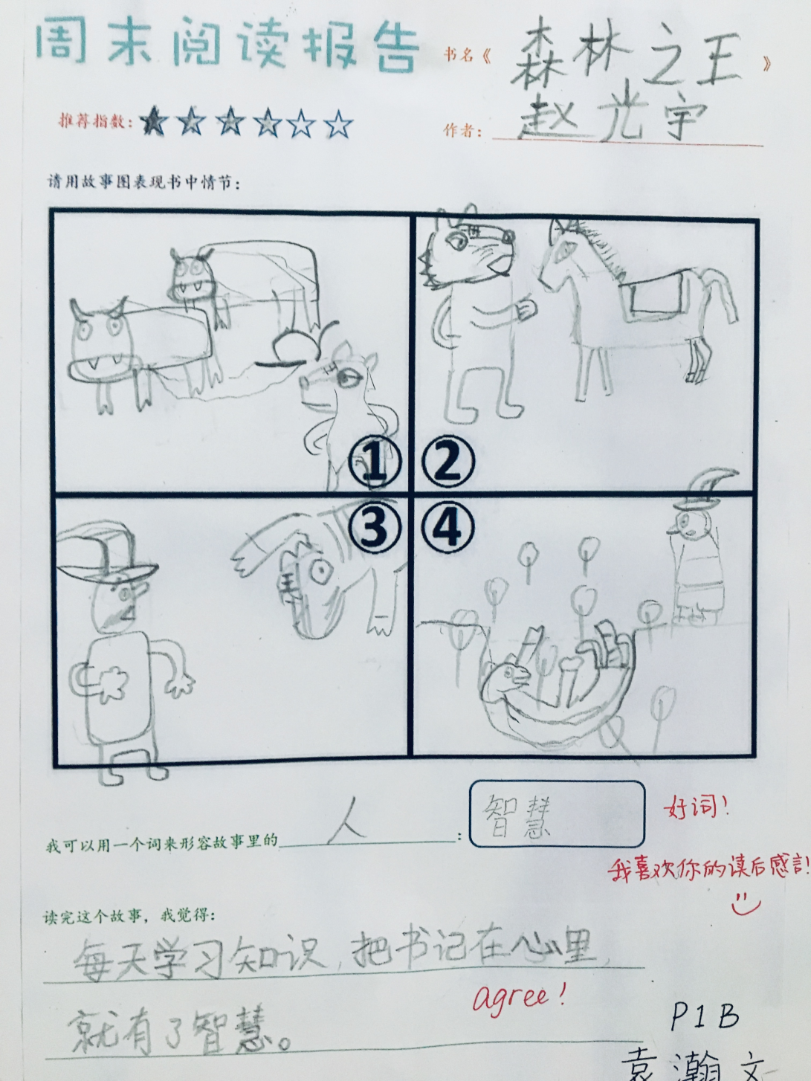
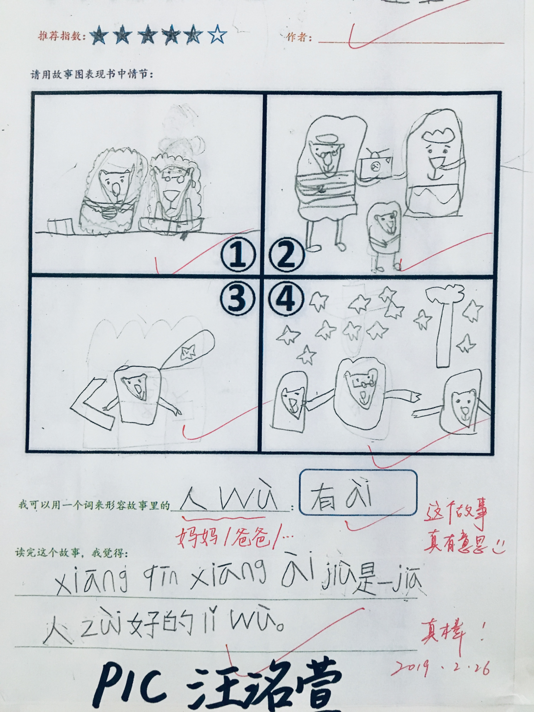

Slide 8
Assessing Phonics
自然拼读评估
Letters and Sounds UK
Phase based learning
Ongoing assessment
英式字母和发音
阶段式学习
进展性评估
Notes:
Regular Phase 1 to Phase 6 Phonics Assessments (in line with our UK Phonics Assessment Programme 'Letters and Sounds' which maps expectations against UK expectations). This measures progress and achievement.

Slide 11
Assessing Speaking & Listening
听说能力评估
Recordings
Programme Expectations
WIDA
录音
读写目标要求
ＷＩＤＡ
Notes:
Speaking and Listening assessments to track students development - in English we map these assessments onto WIDA scores, which is an international assessment system for measuring what students can do at different levels in Grades 1-2 and Grades 3-5. This measures progress and achievement.

Slide 12
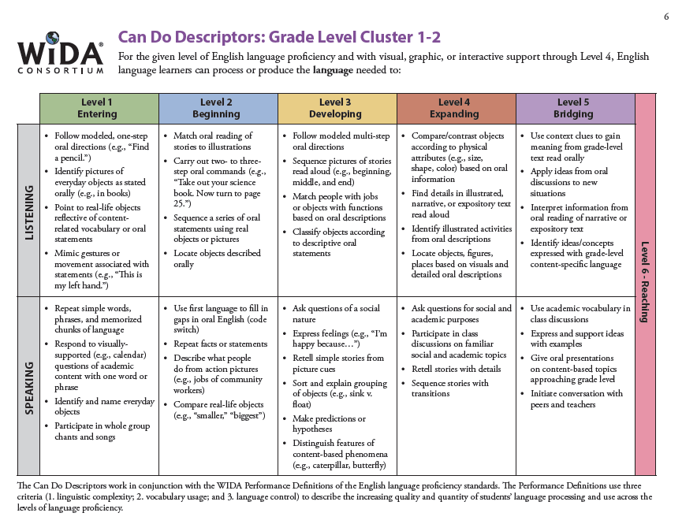

Slide 13
Key reflections from Prep 4 | Moderation is essential across P3-5. P3 and P4 Speaking and Listening Programme Expectations are the SAME. Implications could be that in P3 students are B-E, P4 are D - C. Explore during English moderation time.
 | Average Sp&L level in Q1 | WIDA Listening level in Q1 | WIDA Speaking level in Q1
Ciel | Beginning | -1 | 1
Elaine | Beginning | -1 | -1
Kevin H | Beginning | -1 | -1
Alger | Beginning | +1 | 1
Leo | Beginning | 1 | 1
Cherry | Beginning | +1 | +1
Eric | Beginning | +1 | +1
Leon | Beginning | +1 | +1
Margaret | Beginning | +1 | +1
Emma | Beginning | +1 | +1
Stephen | Beginning | +1 | +1
William | Beginning | +1 | +1
Charlie | Developing | 2 | 2
Collin | Developing | 2 | 2
Simon | Developing | -3 | +3
Jackie | Developing | 2 | +3
Jade | Developing | +3 | +3
Kevin Z | Developing | 3 | +3
Coco | Developing | +3 | +3
Emily | Consolidating | +4 | +4
Star | Consolidating | +4 | +4
Isabella | Consolidating | +4 | +4
Zoe | Consolidating | +4 | +4
Kimberly | Consolidating | +4 | +4

Slide 14
Assessing Writing
写作评估
Programme Expectations
Partner School Moderation
Target Setting
写作目标要求
柏朗思学校审核
目标制定
Notes:
Writing Moderations - I compare writing samples of our students to students at our UK partner school to identify how we are developing in comparison to English pupils. This measures achievement and identifies next steps.

Slide 15
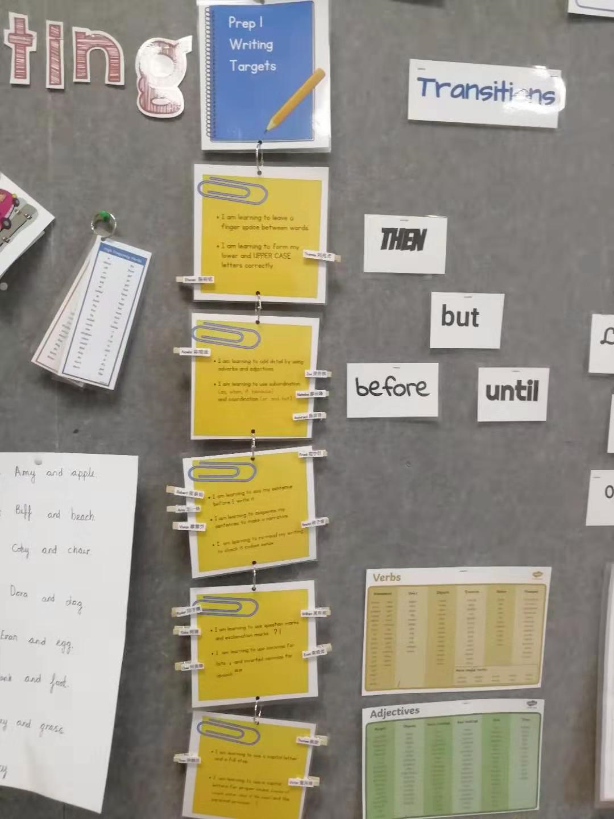
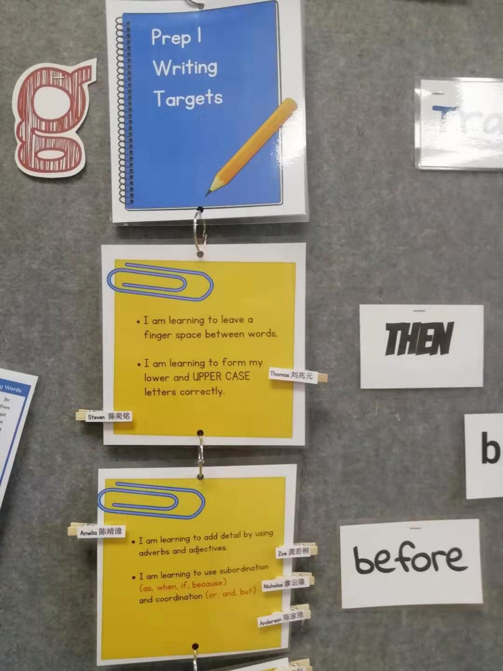

Slide 16
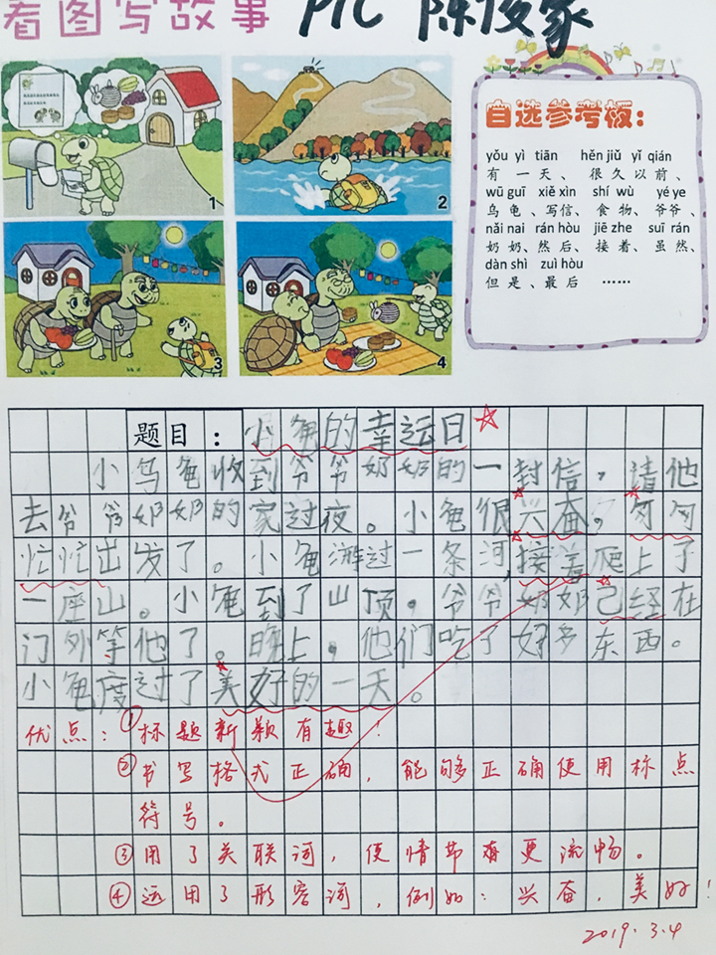
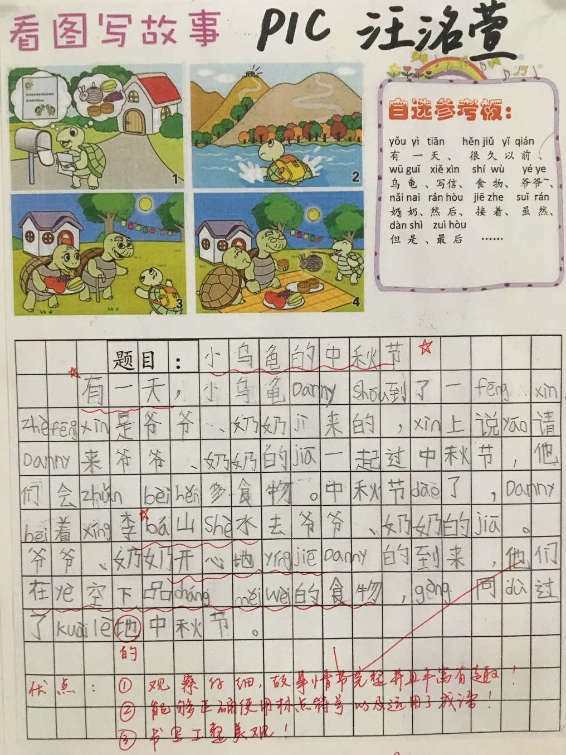

Slide 17
Assessing Maths - PTM
数学评估－PTM
Partner School Alignment
Annual Progress
Benchmarked with UK attainment
柏朗思学校同步
年度进展
英国数学检测评估
Notes:
PTM (Progress Test in Maths) - which has been introduced this year and measures students Maths achievement using an English Maths assessment system, which is delivered in English via our iPADS through a company called GL Assessment. This is used by Bromsgrove School UK as well. We need to wait until the end of the year for Prep 2 to take their test as this is the age group for which the tests begin, but Prep 3-5 also took these at the start of the year to allow us to track their progress over the school year. This measures progress and we can compare our outcomes to our partner school too.

Slide 18
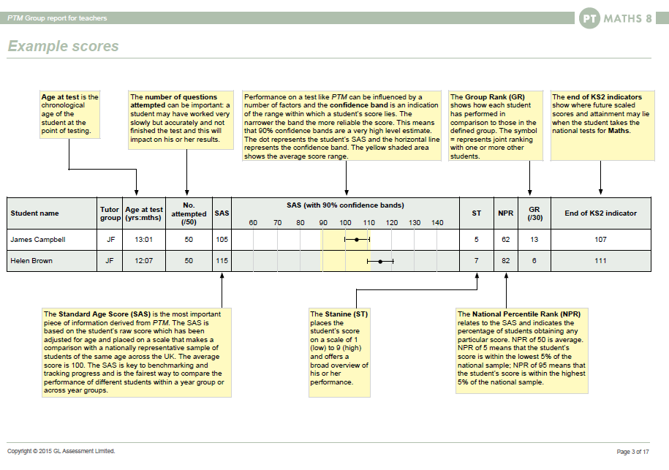

Slide 19
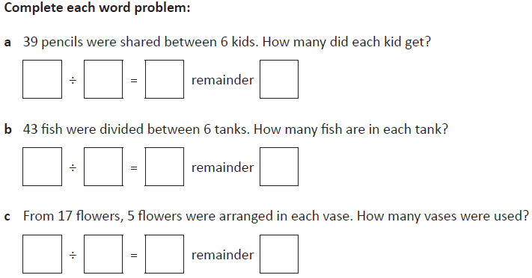
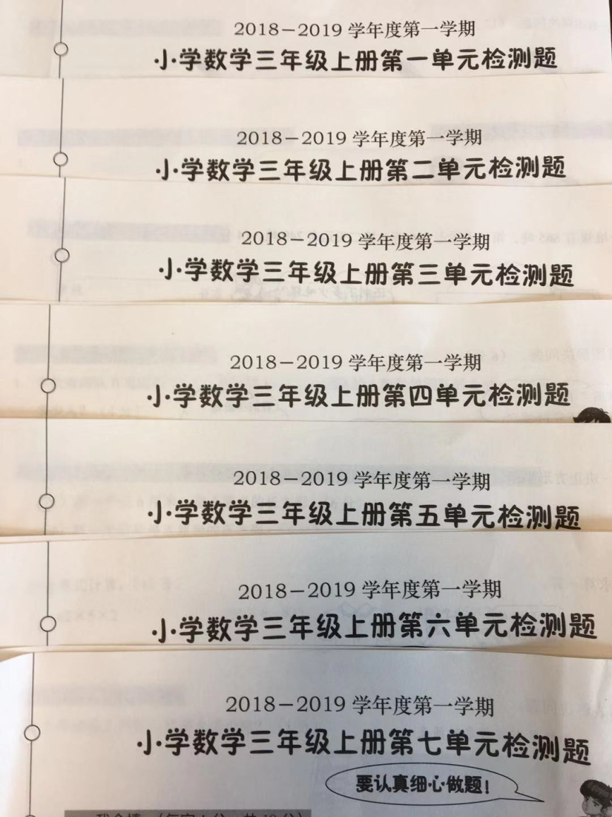

Slide 20
Local Assessments
国内评估
Core Skills including Maths and Chinese
Regular in class
+ Formal Examinations
数学语文的核心能力评估
课堂规律评估
官方测评
Notes:
Local Government Assessment papers for Maths and Chinese learning - Maths and Chinese teachers carry these out using standard assessment formats on a regular basis, within or across units of Maths and Chinese learning as appropriate to ensure students have acquired the knowledge and skills from those units. This measures achievement and for older grades allows us to compare our scores to local averages as well.

Slide 21
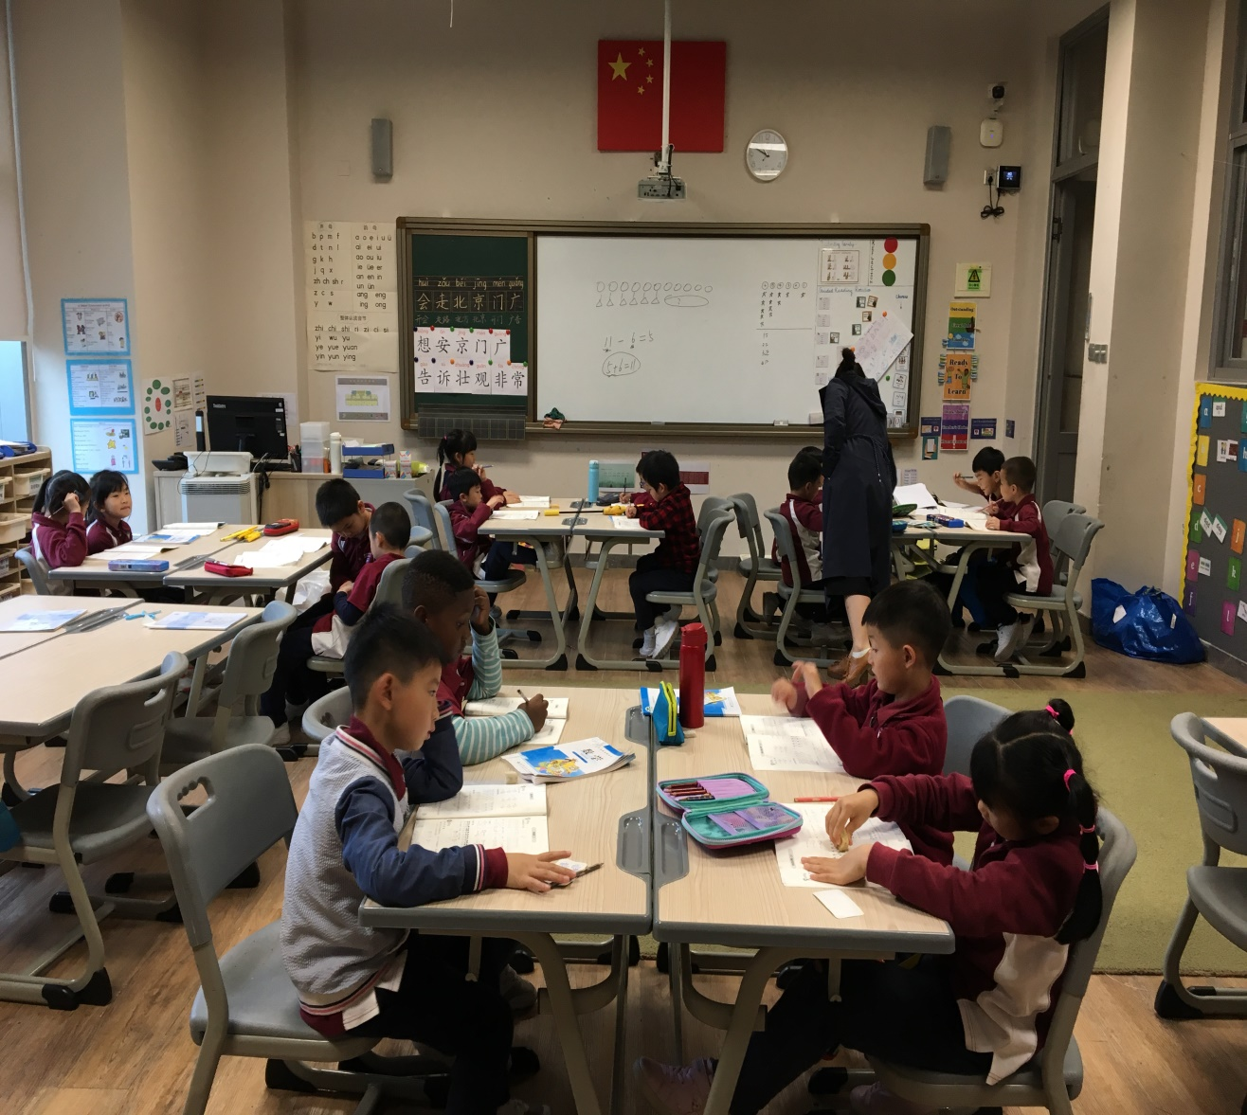
第一单元 | 第二单元 | 期中考试 | 第三单元 | 第六单元 | 数一数 | 认识更大的数 | 人口普查 | 国土面积 | 近似数 | 从结绳计数开始 | 练习一 | 单元练习一 | 线的认识 | 相交与垂直 | 平移与平行 | 旋转与角 | 角的度量1
91 | 良好 | 88 | 100 | 83 | A+ | A+ | A+ | A+ | A | A+ | A | A | A+ | A+ | A | A+ | A
95 | 良好 | 88 | 87 | 98 | A+ | B | B+ | A+ | A | A | A | B | A+ | B | A | A+ | A
66 | 一般 | 53 | 20 | 75 | B | A | A | A | B | A | A | A | B | A+ | A+ | A+ | B+
98 | 优秀 | 101 | 96 | 105 | A+ | A | A | A+ | B | A+ | A+ | A+ | A+ | A+ | A | A+ | A+
86 | 良好 | 79 | 93 | 105 | A+ | A+ | A | A | A | A+ | A | A | A | A+ | B | A | B+
61 | 一般 | 85 | 80 | 79 | A+ | B | B+ | B+ | B | A | B | B | A+ | B | B | A+ | A
78 | 良好 | 85 | 51 | 66 | A+ | B+ | A | A | A | A | A | B | A | A+ | A | B | A
96 | 良好 | 84 | 88 | 106 | A+ | B | A | A | B | A+ | A | A | A+ | B | B | A+ | A
82 | 良好 | 83 | 87 | 83 | A+ | B | A+ | A | A | A+ | A | B | A+ | A | B+ | B+ | A
98 | 良好 | 98 | 98 | 104 | A+ | A | B | A+ | A | A | B+ | A+ | A- | A | B | A+ | B+
100 | 良好 | 101 | 94 | 103 | A+ | B | B | B | B | B | A | A | A+ | B+ | A+ | A | A+
42 | 一般 | 65 | 41 | 31 | A | B | A- | B+ | B | A+ | A+ | B | B | B+ | B+ | A | B
85 | 良好 | 75 | 89 | 20 | A | B | A | B | A | A+ | B | B | B | A | A+ | A+ | B+
80 | 一般 | 75 | 55 | 84 | A+ | B | B+ | B | B | B | A+ | A | A | A | A+ | A | B
86 | 良好 | 74 | 85 | 99 | A | A | A | B | B | B | A | B+ | A | A+ | A+ | A | B+
71 | 一般 | 63 | 89 | 80 | A+ | B | A+ | B | A | B+ | B | B | A | B | B | B | A
94 | 良好 | 80 | 87 | 90 | A | A | B | A | B | A+ | A | A | A+ | A+ | A+ | A+ | A
97 | 良好 | 82 | 70 | 95 | A+ | A+ | B+ | A | B | A+ | B | B | A+ | A | A+ | A+ | A
80 | 一般 | 66 | 71 | 57 | A+ | B | B | A | B | A | B | B | B | B | B | A | B+
64 | 一般 | 66 | 67 | 83
59 | 一般 | 52 | 60 | 30 | A+ | B | A | B+ | A+ | A | B | B | B | B | B | A | A
68 | 一般 | 37 | 65 | 57 | A+ | B | A- | B | B | B | B | B | A | B | A | A | B+

Slide 22
Thinking and Inquiry
思维和探究评估
Inquiry
Higher Order Thinking
Skills rather than knowledge
探究
高阶思维
能力评估而非知识评估
Notes:
Inquiry Units measure the Higher Order Thinking Skills that children have learnt by identifying the key inquiry skills they will be focusing on through a unit and designing assessments to focus on what they understand and can do at the start and then the end of a unit. This measures progress and achievement.

Slide 23
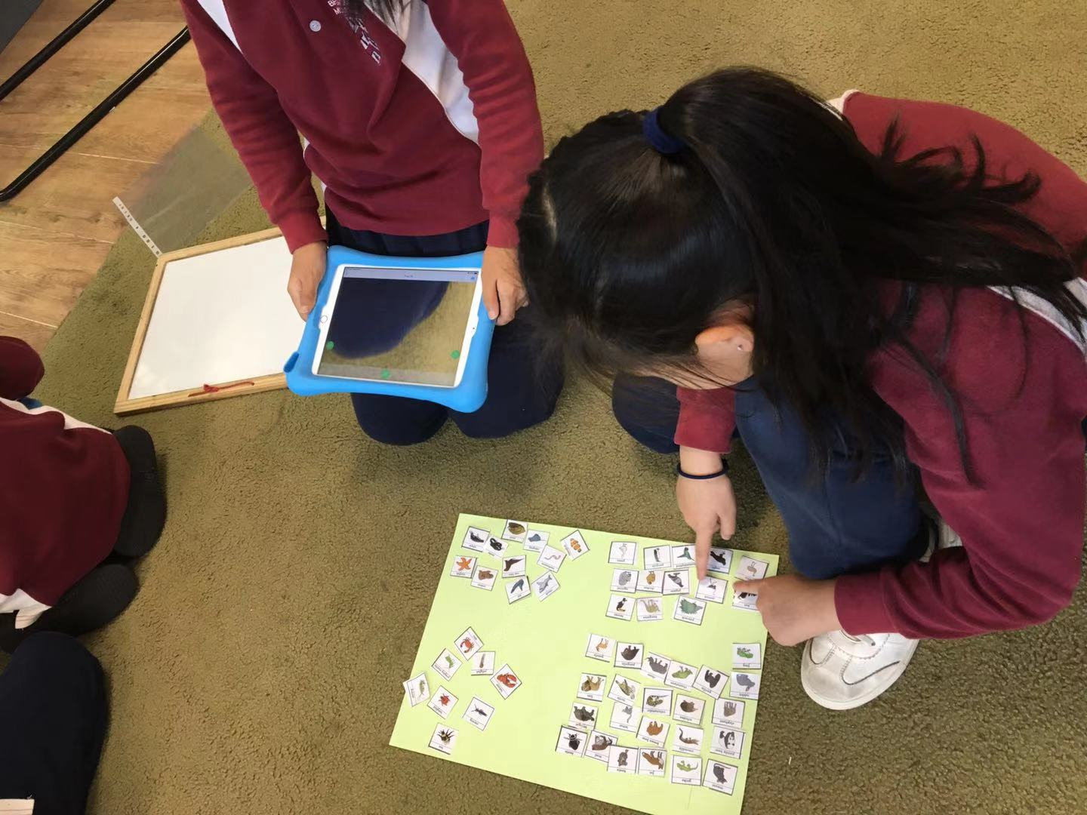
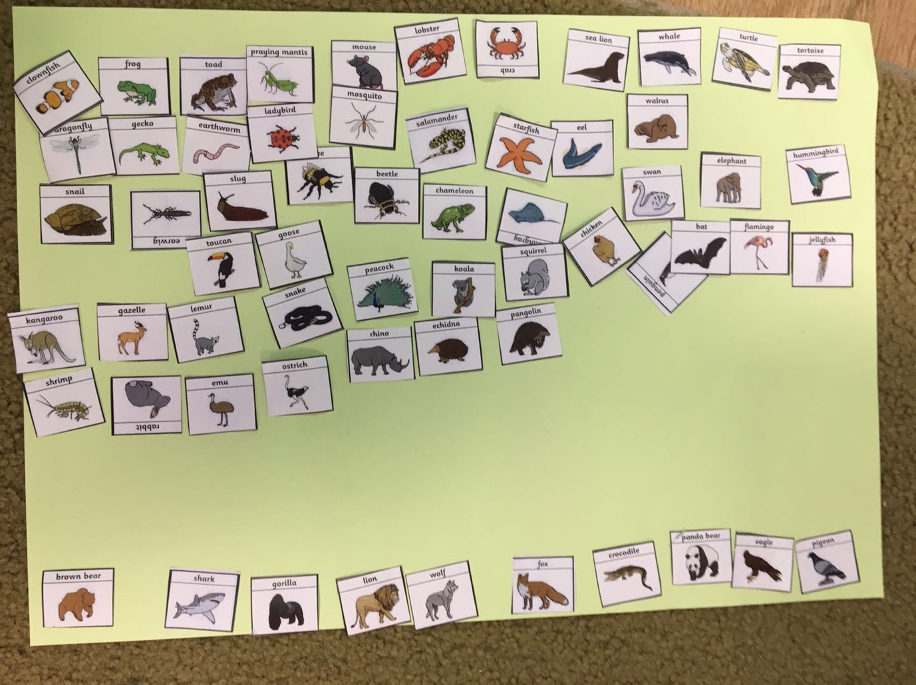

Slide 24
Understanding your Report
如何理解报告
B/D/E/C Beginning/Developing/Embedding/Consolidating
Programme Expectations
Evolving and Aspirational
形成期、发展期，内化期，巩固期
愿景
蓬勃发展，远大抱负
Notes:
Teachers map coverage of skills against our Programme Expectations for the different areas of learning to ensure they are planning a broad and balanced curriculum in line with our learning goals. This measures coverage of content and skills.

